Slide 1
Regional Trade Agreements and the Spread of International Labour Standards Jean-Marc Siroën & David Andrade PSL Research University, Université Paris-Dauphine, IRD, LEDa, UMR [225], DIAL, 75016 Paris, France. Funding by European Commission, FP7, NOPOOR project (Enhancing Knowledge for Renewed Policies against Poverty)
Universidad Nacional de Córdoba
Instituto de Economía y Finanzas
01/12/2017

Slide 2
Introduction
The effect of trade on labor rights is a source of controversy in both public opinion and the academic literature (Siroën, 2012).
The first WTO Ministerial Conference(Singapore, 1996), declared that only the International Labour Organization (ILO) could deal with labour issues
ILO Declaration on Fundamental Principles and Rights at Work (1998) that have to be respected by all members, even with no ratification
In some countries (United States, Canada,…) civil society (NGOs, trade unions) has rallied to demand the inclusion of labour standards in trade agreements, as required by US trade law. In EU : inclusion in a chapter devoted to sustainable development (Siroën, 2013).

Slide 3
The eight ILO Fundamental Conventions
Freedom of association: Freedom of Association and Protection of the Right to Organise Convention (C087); Right to Organise and Collective Bargaining Convention, 1949 (C098);
Forced labour: Forced Labour Convention (C029); Abolition of Forced Labour Convention (C105);
Discrimination: Equal Remuneration Convention (C100); Discrimination (Employment and Occupation) Convention (C111);
Child labour: Minimum Age Convention (C138); Worst Forms of Child Labour Convention (C182).
Remark: These clauses should aim to promote sustainable development and the reduction of poverty. Many of the UN’s Sustainable Development Goals (SDG) are concerned: “no poverty”, “gender equality”, decent work and economic growth”, “reduced inequality” and “partnership for the goals”.

Slide 4
ILO convention ratification and trade agreements. 1980-2013

Slide 5
Issue and hypothesis
Issue
Hypothesis
This article discusses whether regional and bilateral trade agreements (RTAs) with labour clauses (as opposed to RTAs without labour clauses) affect
the number of ILO conventions ratified
compliance with workers’ rights.
It is easier to ratify conventions than to improve workers’ rights.
The inclusion of labour clauses makes the agreement more politically acceptable (Kim, 2012), although this does not directly improve labour rights.
We expect the impact of RTAs comprising labour clauses to be positive on ILO convention ratification and stronger than on labour rights practices.

Slide 6
Litterature
Peksen and Blanton (2016) find that the ratification of core ILO conventions is negatively associated with the level of respect for worker rights.
Kamata (2014) trade with a partner signatory to an RTA with labour clauses has a positive impact on labour earnings mainly in middle-income countries. However, labour clauses might reduce the trade-promoting effect of RTAs for middle-income countries especially when the partner is a high-income country.
Brown, Deardoff and Stern (2011) find that the US-Cambodia Bilateral Textile Trade Agreement, which includes labour provisions with “positive” sanctions, has contributed to a modest improvement in labour conditions.
Van Roosendaal (2015),, argues that the effects of the inclusion of labour standards in the CAFTA-DR have been limited.
Kim (2012) : US trade agreements (from 1982 to 2005) : countries improve their labour standards before signing the RTA knowing that this will increase their attractiveness as potential RTA partners.
Postnikov & Bastiaens (2014), that improvements in labour rights in countries that have signed RTAs with the EU are ex post rather than ex ante.

Slide 7
Data and method
Endogenous variable : Number of ratified “core” Conventions (ILO) and Index CIRI on workers’ rights mainly based on core fundamental standards.
Exogenous variables : inclusion of labour clauses in RTAs .
Kamata (2015): RTAs notified to the WTO ; 6 groups according to the scope, depth and strength. 1 to 3 : agreements are those that require or urge domestic labour laws to be consistent with the ILO guidelines or mention the members’ commitment to the ILO standards without requiring labour laws.
Relative intensity of trade has with labour-clause-inclusive (LC) (group 1 to 3) RTA partners
$${TradeRTA}_{it}^{LC}= {RTA}_{it}^{LC} \left(\frac{\sum{{exports}_{ijt}}}{{total exports}_{it}}\right)$$
Similar indicator when no labour standards (NC ; group 4 to 6)
Reference : share of trade without RTAs (whatever labour clause)
Tobit model: takes into account the endogenous variable’s censored nature (between 0 and 8 or 1 to 3).
Unbalanced panel data for 141 countries and 34 years, control for time-invariant individual country characteristics not accounted for by including random effects in the Tobit estimation.

Slide 8
Effects of RTAs on the Number of Conventions Tobit Model with Individual Random Effects and Year Fixed effect
Number of ratified ILO Conventions | 1-year lag | 2-year lag | 3-year lag
Conventions Ratified in (t-1) | 1.025*** | 1.001*** | 1.041***
TradeRTAlc (t-n) | 0.259*** | 0.331*** | 0.257***
TradeRTAnc (t-n) | 0.071 | 0.025 | 0.041
logGDP p.c. (t-n) | -0.063*** | -0.079*** | -0.057***
FDI (t-n) | 0.001 | 0.004 | 0.004
Population (t-n) | -0.002*** | -0.004* | -0.002*
IndustryVA (t-n) | 0.003* | 0.003 | 0.002
Political Rights (t-n) | -0.003 | -0.000 | 0.007
Civil Liberties (t-n) | -0.021 | -0.044* | -0.023
Federalism_(t-n) | -0.043 | -0.028 | -0.071*
Constant | 0.817*** | 1.193*** | 0.564***
N | 3078 | 2994 | 2902
∗ p < .05, ∗∗ p < .01, ∗∗∗ p < .001.
Inclusion of labour clauses in RTAs has a positive and significant effect.
Trade under PTAs without labour clauses is never significant.

Slide 9
Effects of RTAs on the CIRI index for Workers’ rights. Tobit Model with Individual Random Effects and Year Fixed ct.
CIRI Index | 1-year lag | 2-year lag | 3-year lag
CIRI Index in (t-1) | 1.193*** | 1.240*** | 1.261***
TradeRTAlc (t-n) | 0.314 | 0.235 | 0.196
TradeRTAnc (t-n) | 0.565** | 0.536** | 0.531**
logGDP p.c. (t-n) | -0.064 | -0.073 | -0.018
FDI (t-n) | 0.005* | 0.006 | 0.005
Population (t-n) | -0.005 | -0.005 | -0.005
IndustryVA (t-n) | -0.007 | -0.008 | -0.012**
Political Rights (t-n) | -0.079 | -0.032 | -0.046
Civil Liberties (t-n) | -0.312*** | -0.379*** | -0.305***
Federalism_(t-n) | -0.059 | -0.044 | -0.097
N | 2646 | 2625 | 2540
Trade agreements with labour clauses do not have a significant effect on labour practices
RTAs without labour clauses display a significant and positive coefficient
Idem Postnikov & Bastiaens (2014)

Slide 10
RTAs and ratification by conventions Probit Model with Random Effects for each Individual ILO Convention. No Time-Fixed Effects
 | C087 | C098 | C029 | C105
Convention | Freedom of Association | Collective Bargaining | Forced Labour | Abolition of Forced Labour
TradeRTAlc | 3.799*** | 4.671 | 0.375 | 2.293
TradeRTAnc | 6.255** | 5.965 | 5.331 | 1.650
 | C100 | C111 | C138 | C182
Convention | Equal Remuneration | Discrimination | Minimum Age | Worst Forms of Child Labour
TradeRTAlc | 3.966* | 6.231 | 2.597* | 0.788**
TradeRTAnc | 6.177** | 6.105** | 4.591*** | 1.532***

Slide 11
Sensitivity and Robustness Checks
Number of ILO Conventions Ratified | All Countries | OECD | Non OECD
Conventions Ratified in (t-1) | 1.025*** | 0.931*** | 1.006***
TradeRTAlc (t-n) | 0.259*** | 0.217** | 0.778***
TradeRTAnc (t-n) | 0.071 | 0.401*** | -0.299**
The effect of labour-clause on ratification is significantly greater for developing countries
RTAs without labour clauses has a significant positive effect on expected ratification in developed countries, negative in developing countries.

Slide 12
Sensitivity and Robustness Checks
CIRI Index for Workers’ Rights | All Countries | OECD | Non OECD
CIRI Index in (t-1) | 1.193*** | 1.757*** | 1.123***
TradeRTAlc (t-n) | 0.314 | 0.184 | 0.195
TradeRTAnc (t-n) | 0.565** | 0.235 | 0.362
RTAs with and without labour clauses have no statistically significant effect for workers’ rights in both groups of countries when we treat them separately.
Convention c182 (worst forms of child labour) – was only initiated in 1998. We test the model from 1998 to 2012.
Ratification and practices : 𝑆𝑖𝑚𝑖𝑙𝑎𝑟 𝑟𝑒𝑠𝑢𝑙𝑡𝑠

Slide 13
Policy Implications
Trade agreements have to include provisions dealing with core labour standards
Countries recognize the legitimacy of the ILO and the core conventions as the benchmark for acceptable working conditions.
However, when enforcement mechanisms are not clearly included, countries may ratify ILO conventions without to comply with them. To some extent, ratification of ILO conventions can be a substitute for compliance with these standards
In this respect, trade agreements could be made conditional on prior ratification of ILO conventions,. Additionally, the agreement should establish a monitoring of the implementation of labour provisions and a follow-up procedure, which should be more attentive to the progression than the level of standards
"Positive" sanctions, such as conditional aid and supplementary trade openness, should provide more incentives than “negative” sanctions such as fines or extra-tariffs (cf. GSP+). EU might schedule an enlargement of preferences, bound to improvements in workers’ rights, eventually targeted on sectors or firms (US-Cambodia agreement).
The ILO conventions also strengthen civil society by conferring the legitimacy of international law. The close involvement of civil society should be considered as fundamental for the successful implementation of the provisions.

Slide 14
References
Brown, D. K., Deardorff, A. V., & Stern, R. M. (2011). Labor Standards and Human Rights: Implications for International Trade and Investment. International Policy Center. Gerald R. Ford School of Public Policy. University of Michigan. IPC Working Paper Series, (119).
Kamata, I. (2014). Regional Trade Agreements with Labor Clauses: Effects on labor standards and trade. Research Institute of Economy, Trade & Industry, IAA. Retrieved from http://www.rieti.go.jp/en/publications/summary/14030004.html
Kamata, I. (2015). Labor Clauses in Regional Trade Agreements and Effects on Labor Conditions: An Empirical Analysis. Kyoto University, Graduate School of Economics, Research Project Center Discussion Paper Series.
Kim, M. (2012). Ex Ante Due Diligence: Formation of PTAs and Protection of Labor Rights. International Studies Quarterly, 56(4). http://doi.org/10.1111/j.1468-2478.2012.00758.x
Peksen, D. & Blanton, R.G. (2016). The impact of ILO conventions on worker rights: Are empty promises worse than no promises?. Review of International Organizations, 1-20
Postnikov, E., & Bastiaens, I. (2014). Does dialogue work? The effectiveness of labor standards in EU preferential trade agreements. Journal of European Public Policy, 21(6), 923–940. http://doi.org/10.1080/13501763.2014.910869
Siroën, J-M (2012). Core labour standards and exports, Working Papers DT/2012/18, DIAL.
Siroën, J.M. (2013). "Labour provisions in preferential trade agreements: Current practice and outlook", International Labour Review, Volume 152, Issue 1, pp. 85–106, March.
Van Roozendaal, G. (2015). The Diffusion of Labour Standards: The Case of the US and Guatemala. Politics and Governance, 3(2), 18–33. http://doi.org/10.17645

Slide 15
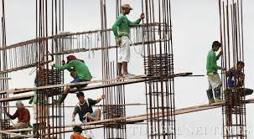
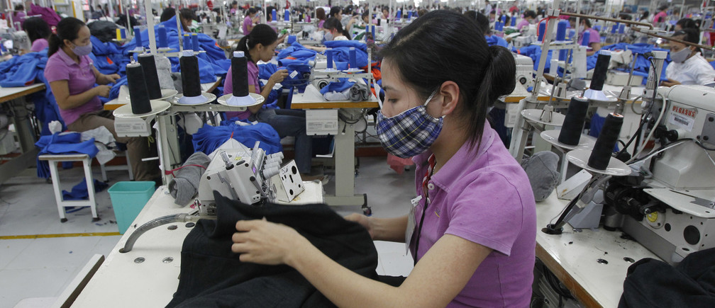
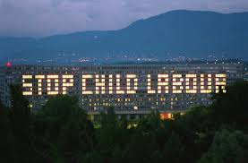
Thanks

